Slide 1
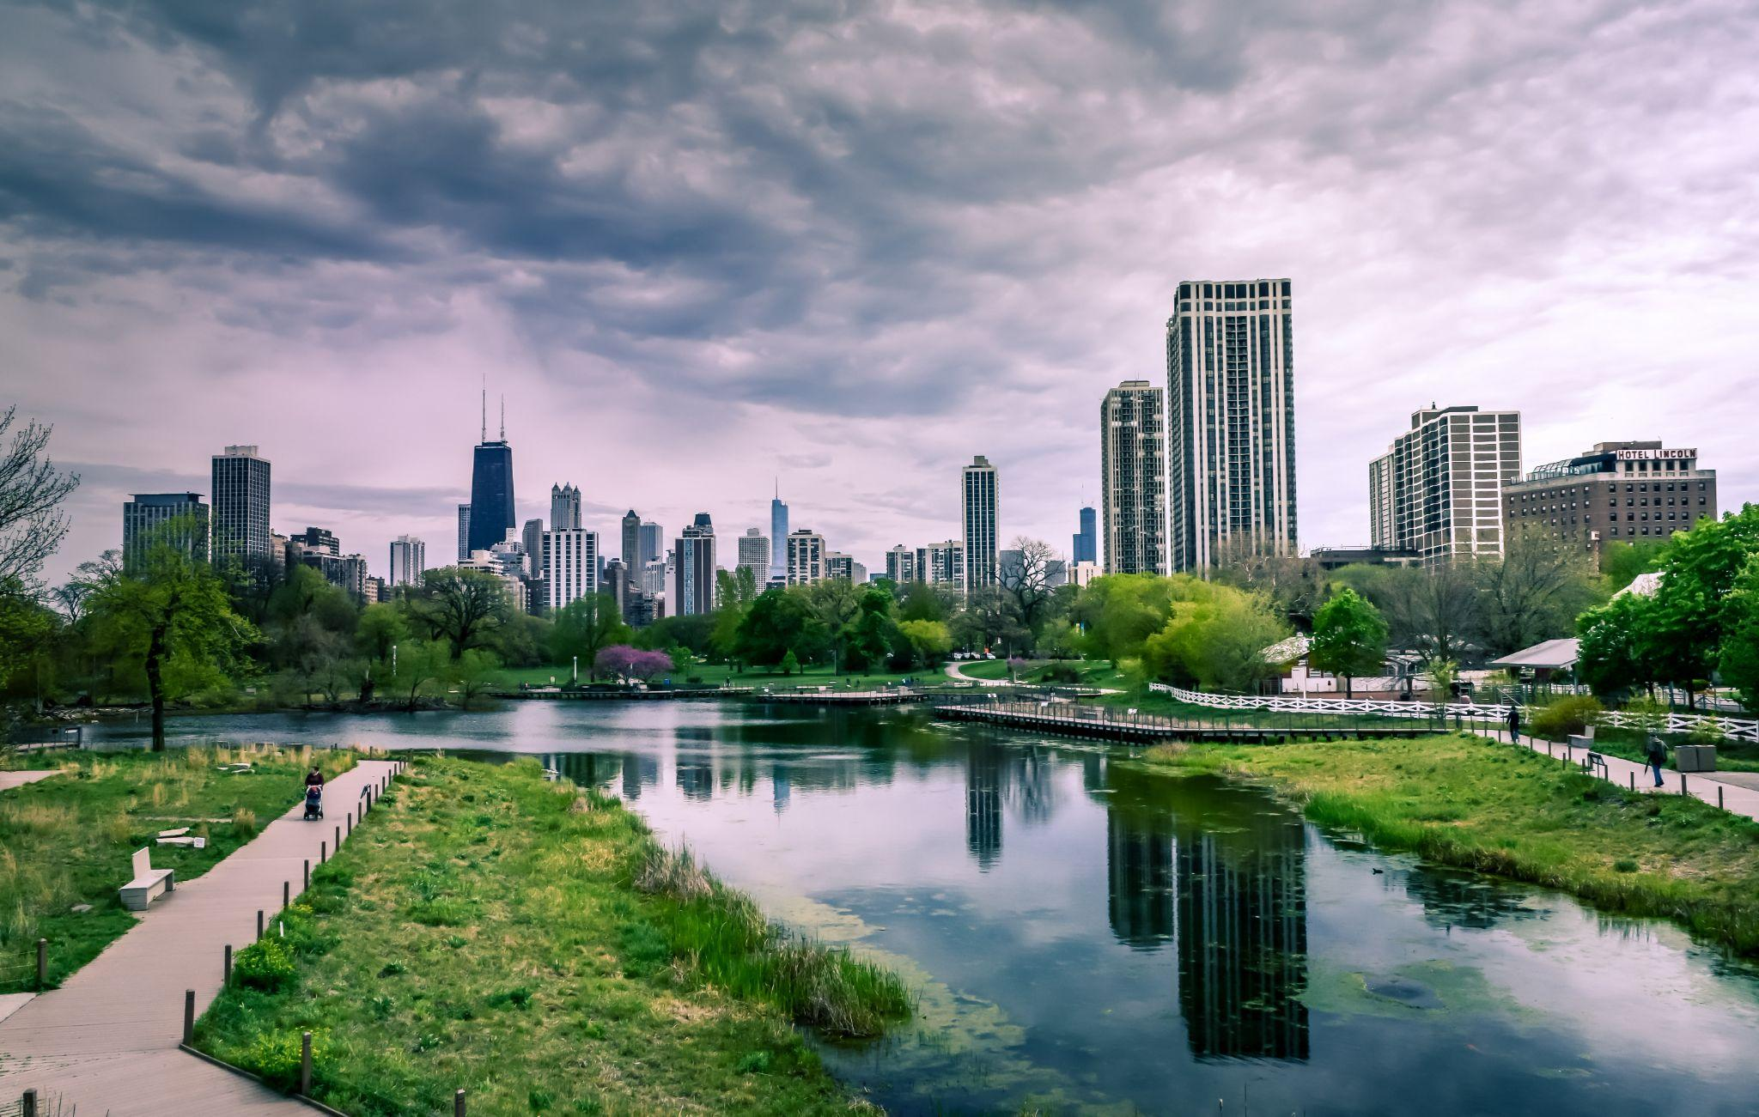
On Climate Adaptive Business Parks
Notes:
Hi all!
I’m here to talk to you today about Climate Adaptive Business Parks. And not just to give you information, but to educate you so that you have the ability to actually make a change yourself. Because I find it very important that in our company/organisation/society, we make sure that we contribute to a better and safer future. Which means a more climate adaptive future.

Slide 2
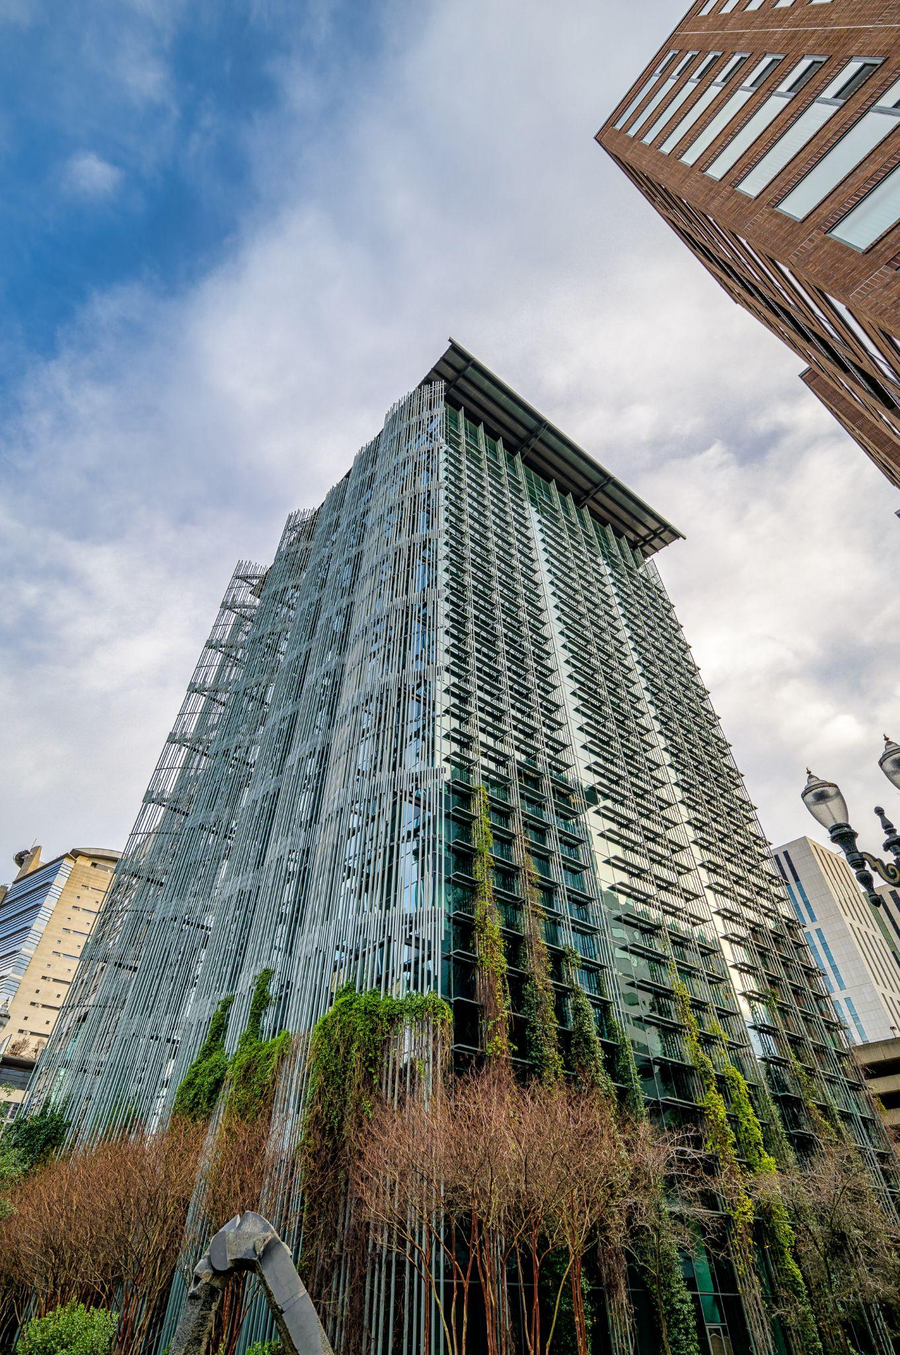
CLIMATE ADAPTATION
‘Climate adaptation refers to adjustments in ecological, social, or economic systems in response to actual or expected climatic stimuli and their effects or impacts. It refers to changes in processes, practices, and structures to moderate potential damages or to benefit from opportunities associated with climate change.’ (IPCC, 2022)
Notes:
But first, what is climate adaptation? Let’s assume that everyone here knows what climate change is. There are two ways that we can go about dealing with climate change. We can mitigate its impact - that is, for example installing solar panels, making sure our ecological footprint is minimized, and climate adaptation. That is to adapt to the changes in the climate that are certain to occur. The following is the definition given by the Intergovernmental Panel on Climate Change.

Slide 3
PROBLEM STATEMENT
01
CURRENT AND FUTURE SCENARIO
02
TABLE OF CONTENTS
PRACTICAL EXAMPLES
03
WHAT CAN YOU DO?
04
CONVERSATION STARTERS
05
Why are business parks not climate adaptive and why is that a problem?
What business parks currently look like and where they could be headed.
How could it also be done?
How can you play a significant role in the process of climate adaptation?
How to start the conversation within your company?
Notes:
In this short presentation I will discuss the following with you:

Slide 4
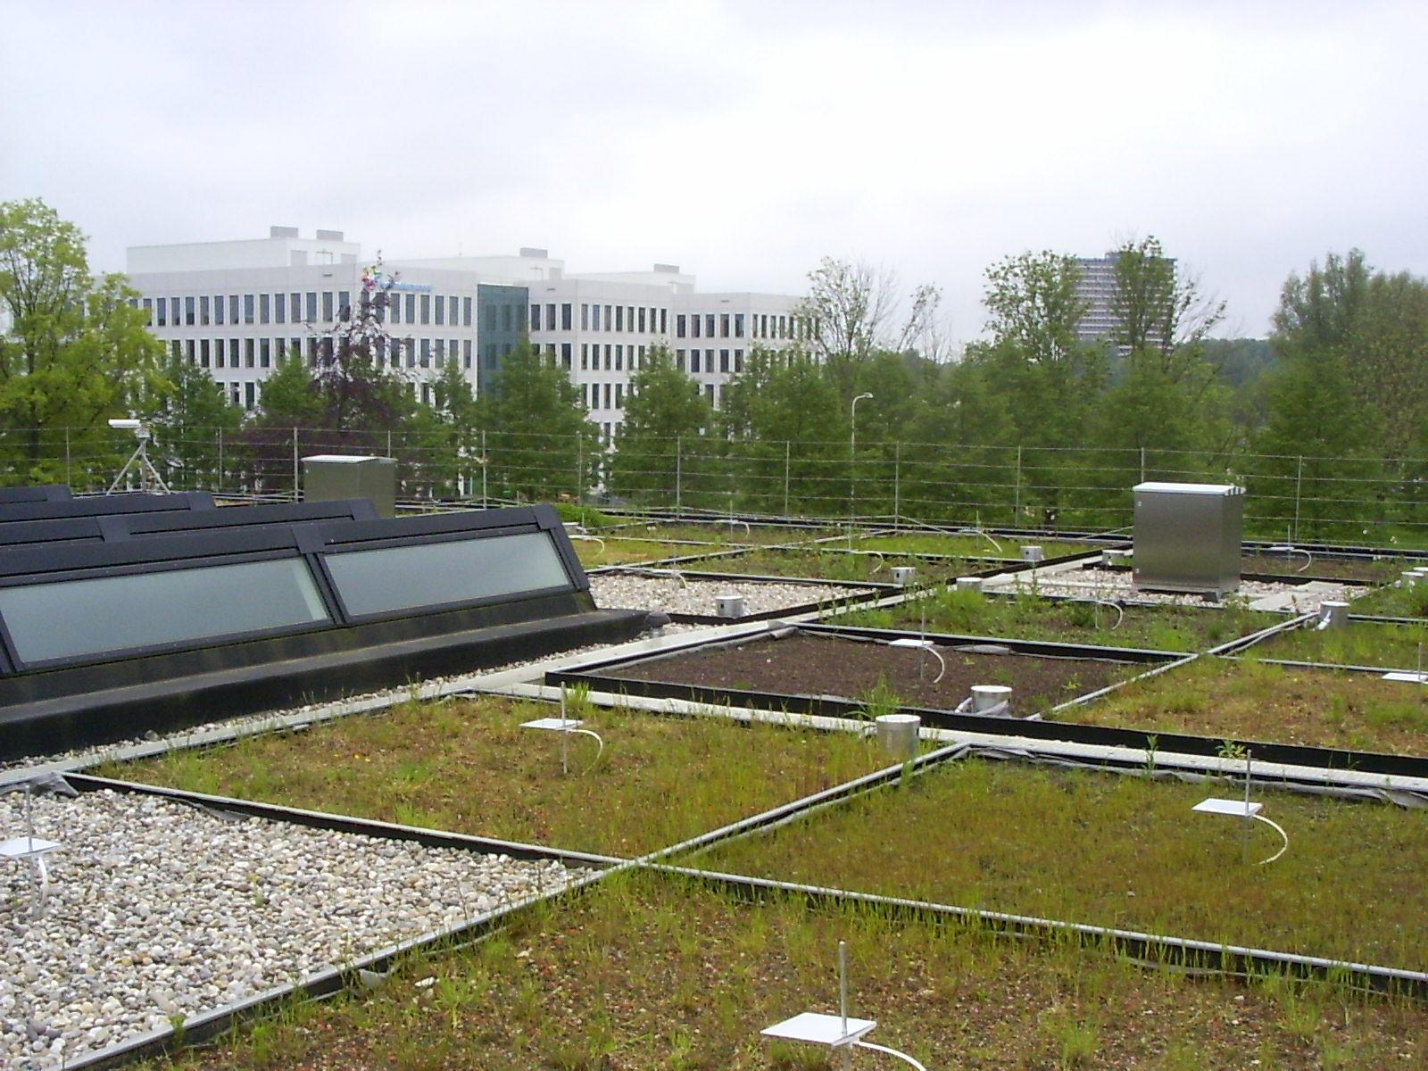
‘What you do makes a difference, and you have to decide what difference you want to make’
- Dr. Jane Goodall, Scientist and Activist
Notes:
This is an example of one of the ways to change a business park. Simply by changing the contents and surface of a roof! As Jane Goodall said, everybody makes a difference on a daily basis. It is up to you to decide on what type of difference you want to make.

Slide 5
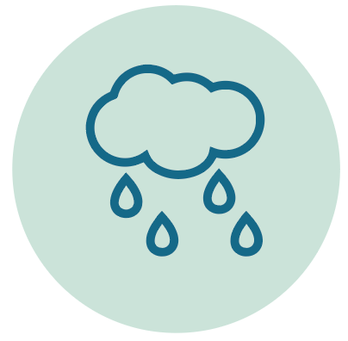
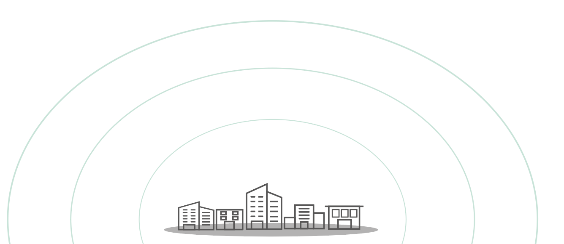
LACK OF GREENERY
IMPERVIOUS SURFACES
Problem
Statement
More rainfall
Higher Temperatures
Many Impervious Surfaces
More people
Lack of Greenery
Lack of Knowledge
Lack of Responsibility
Little Sense of Urgency
Little Means of Financing
Notes:
Let me tell you about the problems that are currently more present than ever on business parks - and especially on business parks in the Netherlands. The main problem are the detrimental effects of climate change - more extreme weather events. This does not only mean more intense rainfall events or storms but also higher temperatures. Because of a lack of greenery and because there are many impervious (black surfaces) water cannot infiltrate into the soil. Higher temperatures are also already a result of climate change, but are further raised because lack of green space and black surfaces retain more heat because they absorb the long wavelength warmth waves from the sun. Although some people are aware of these problems, many are not, there is a lack of responsibility, of urgency and little means of financing are available because people don’t feel responsible. That the area is increasingly crowded with people including not only working but also living in the area requires that this is taken seriously.

Slide 6
BUSINESS PARKS ARE WHERE THE MONEY IS
BUSINESS PARKS HAVE VITAL SPATIAL VALUE
WHY TAKE ACTION ON BUSINESS PARKS?
BUSINESS PARKS HAVE MUCH POTENTIAL FOR IMPROVEMENT
BUSINESSES WILL GET RETURN ON INVESTMENT
Climate adaptation measures have to be financed. And this cannot solely be done by the municipality, activist groups. It is a joint effort.
Business parks are often located close to or in central areas of cities. When they experience or contribute to more heat stress, increased flooding chances, this has implications for the city.
Business parks have high potential to make great changes to them, as they contain so much grey space.
In addition to reduced energy costs as a result of better insulation, when extreme weather events occur, the investments on climate adaptive measures will increasingly save money and prevent uncalculated costs.

Slide 7
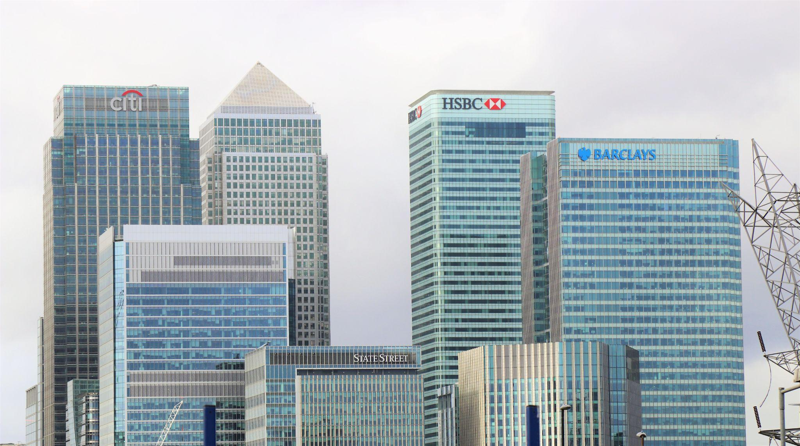
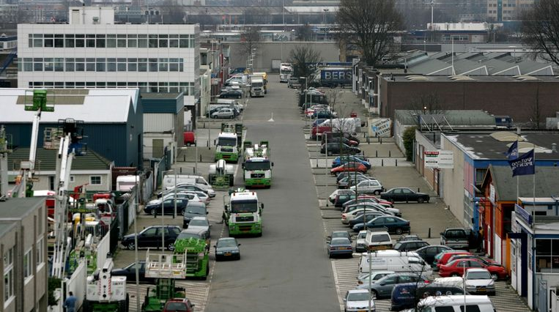
NOW
Many business parks are still grey, concrete areas that are not adapted to a changing climate yet. During intense weather events, these areas are not a preferable place to be due to their disability to cope with these weather extremes.
Notes:
This is the current state of many Dutch business parks. They’re not necessarily attractive places and do not stimulate a healthy working climate for its users. On this picture too, you can see a lot of impermeable surface, both on the ground level and on the roofs. The concrete nature of all this further increases the heat. The overarching mobility type are cars or heavy trucks and the amount of places for green and relaxation are scarce.

Slide 8
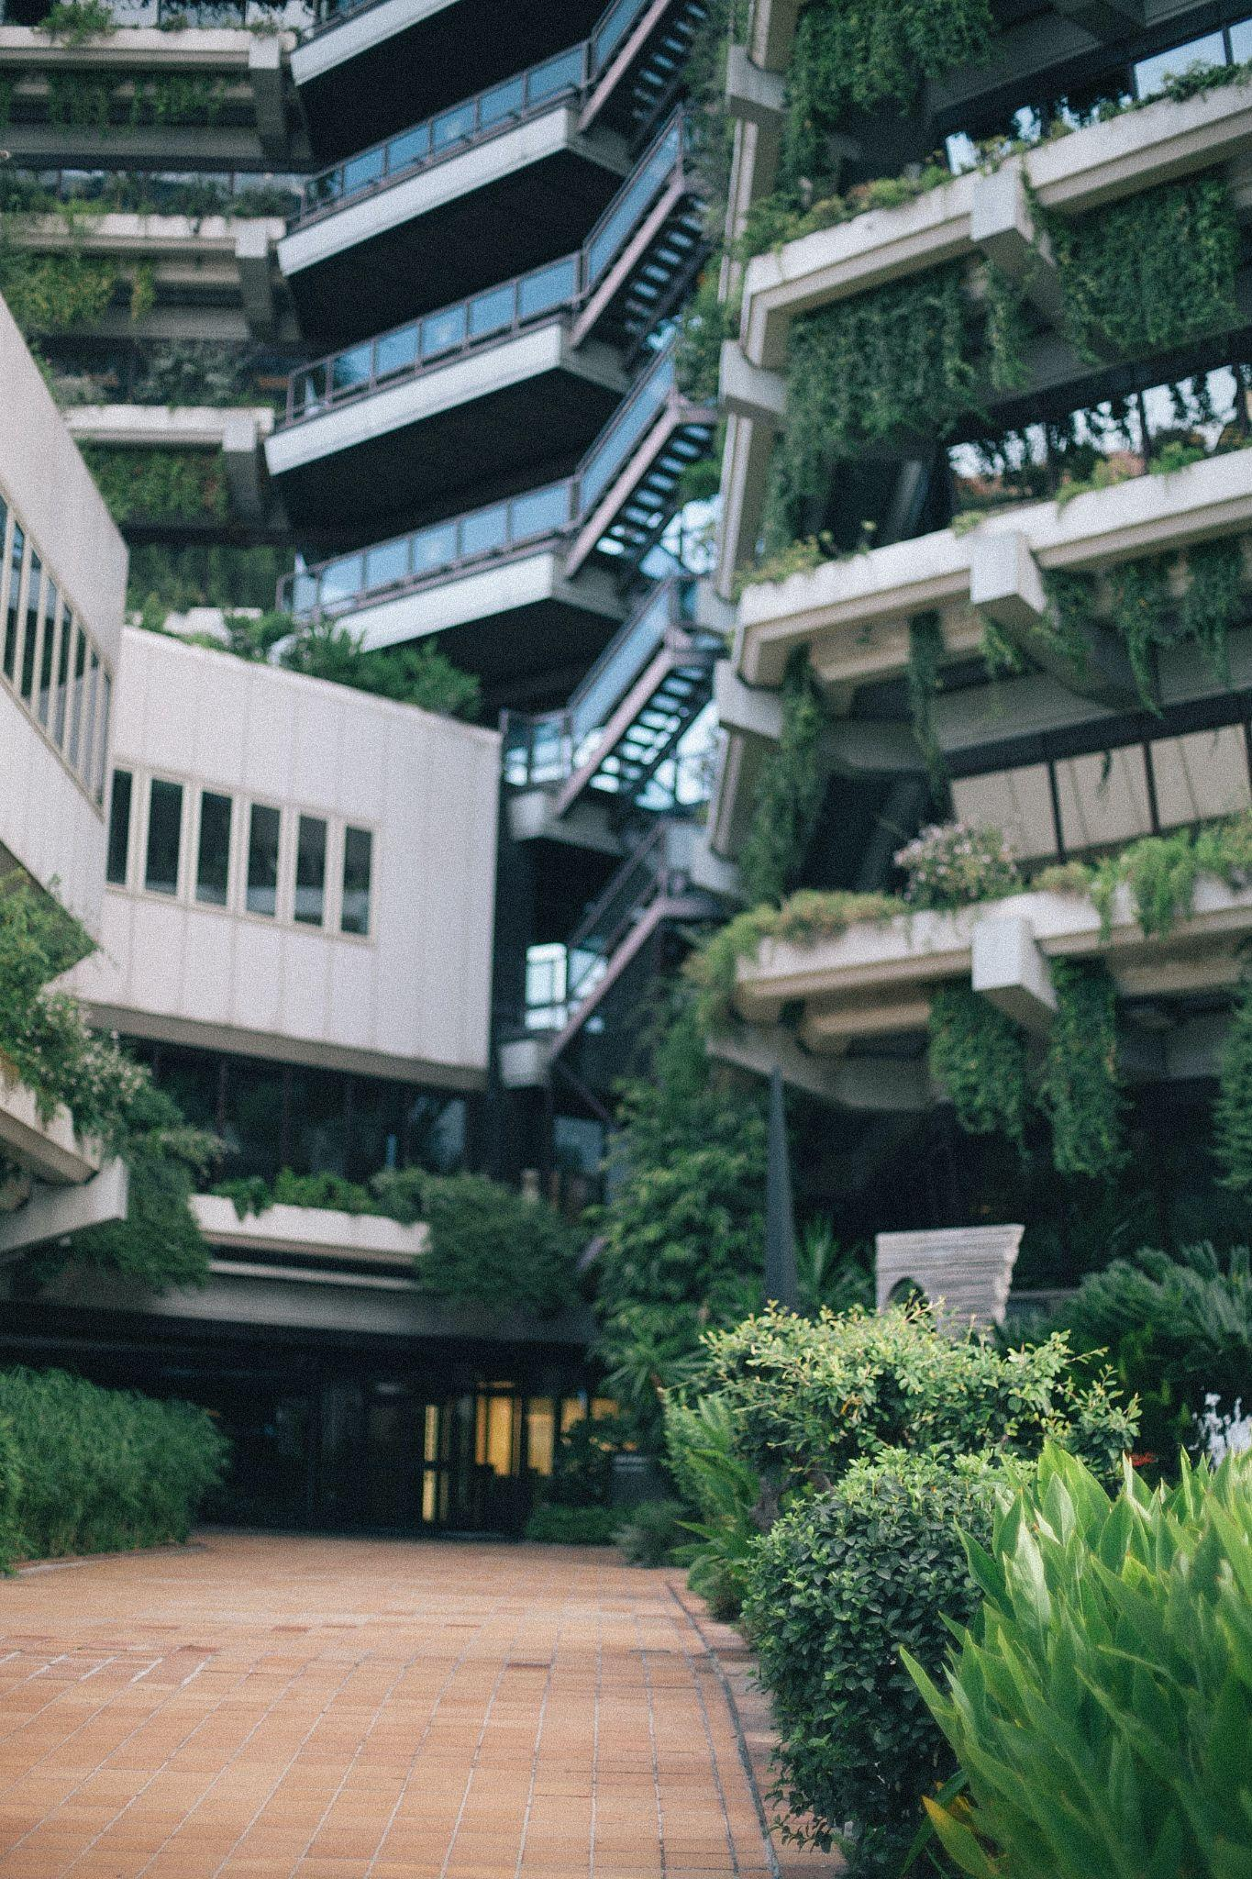
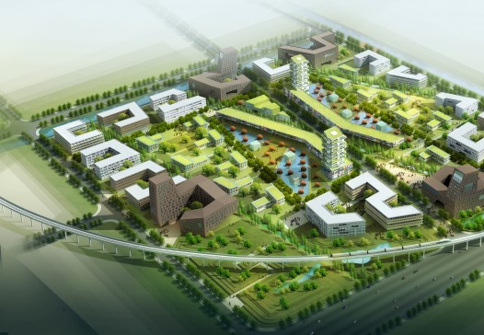
FUTURE
A greener business park is more climate adaptive, has many permeable surfaces and much space for green and biodiversity.
Notes:
Greener business parks are not only more climate adaptive - so they not only are better for dealing with the changes in climate and limiting the detrimental effects of that, they are also healthier spaces. Greener working environments have been determined to contribute to healthier employees (and in the case of most mixed-use business parks in the Netherlands, also healthier citizens.

Slide 9
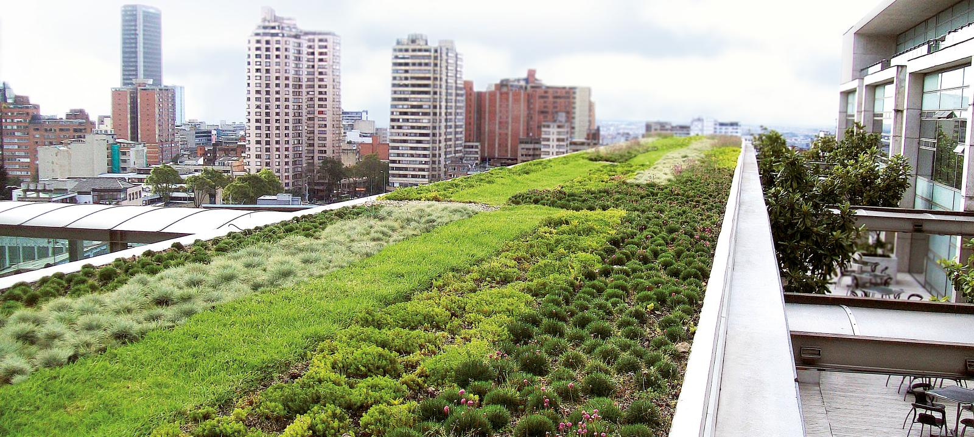
GREEN ROOFS
POTENTIAL SOLUTIONS
RAIN BARRELS
PERMEABLE PARKING SPOTS
Next to bringing large aesthetic value, green roofs realise better insulation, water retention and biodiversity.
As an attractive and affordable option, rain barrels retain water when it is in overflow and let it go into the ground when plants could use it.
These provide more possibility for water to be retained. Which is good for the groundwater levels, but also reduces flood risk.
Notes:
These are some potential solutions that could be implemented. Some - such as the rain barrels or permeable parking spots - are easier than others.
As average summer days tend to get hotter, roof temperatures of over 80 degrees Celsius are not unusual, affecting the internal climate - which increasingly affects labour productivity and the production processes of any business. On conventional rooftops, the water flows directly to the sewage system via the rainwater pipes. Future more intense rainfall events will lead to fast overflow of the sewage system and to increased flood risk on the ground level. So, vacant roof space is finding new uses for the better. It’s time to re-roof your building!
Capturing some of the rainwater runoff from buildings and rooftops could play an important role in protecting your business from floods. Over the past years, rain barrels have grown in popularity as one of the simplest and most effective methods to implement a climate adaptive measure. They can also be made smart, when connected to the local weather forecast.
Green parking spaces are permeable which allows water runoff and vegetation growth - and will therefore limit flood risk and heat stress. It is an easily implementable solution for any business, with direct beneficial effects for everyone in the surrounding. Let’s get started!

Slide 10
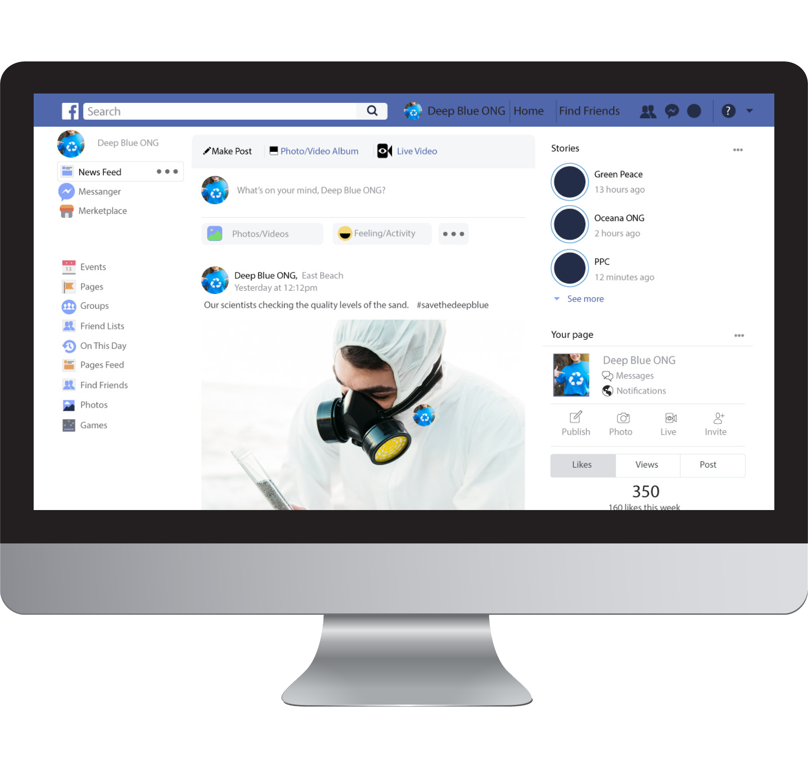
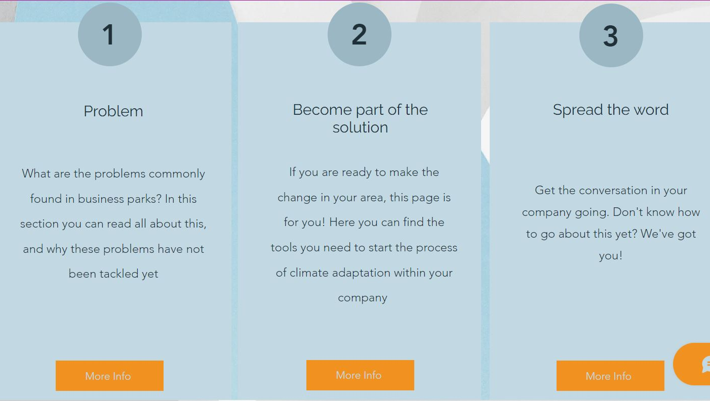
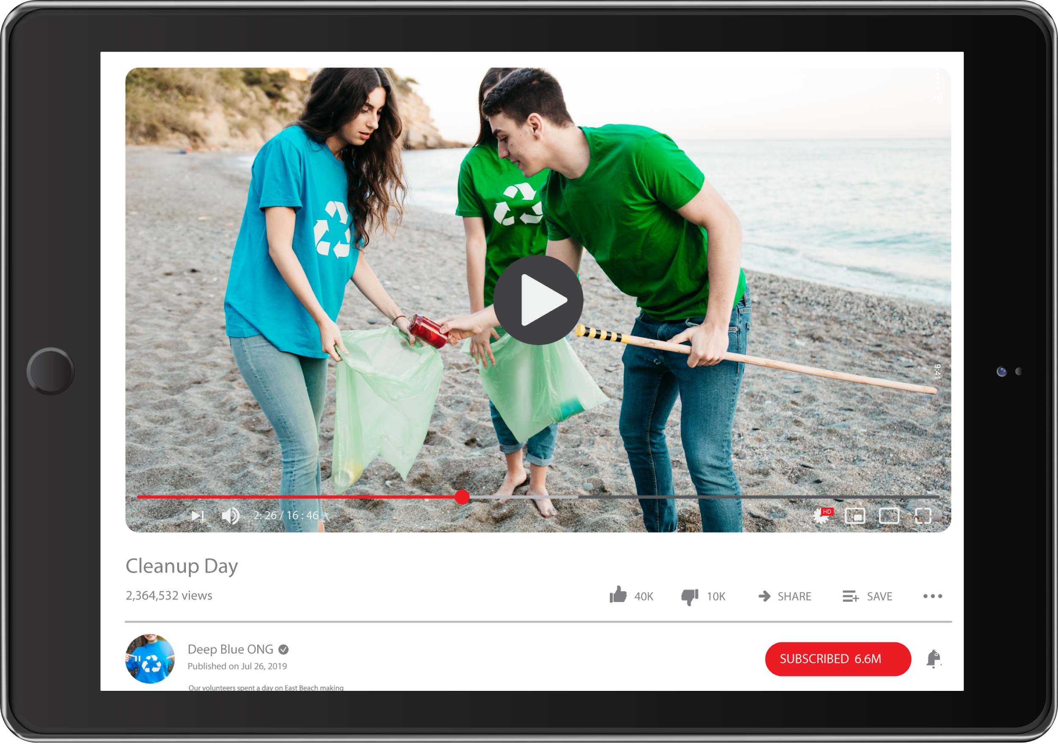
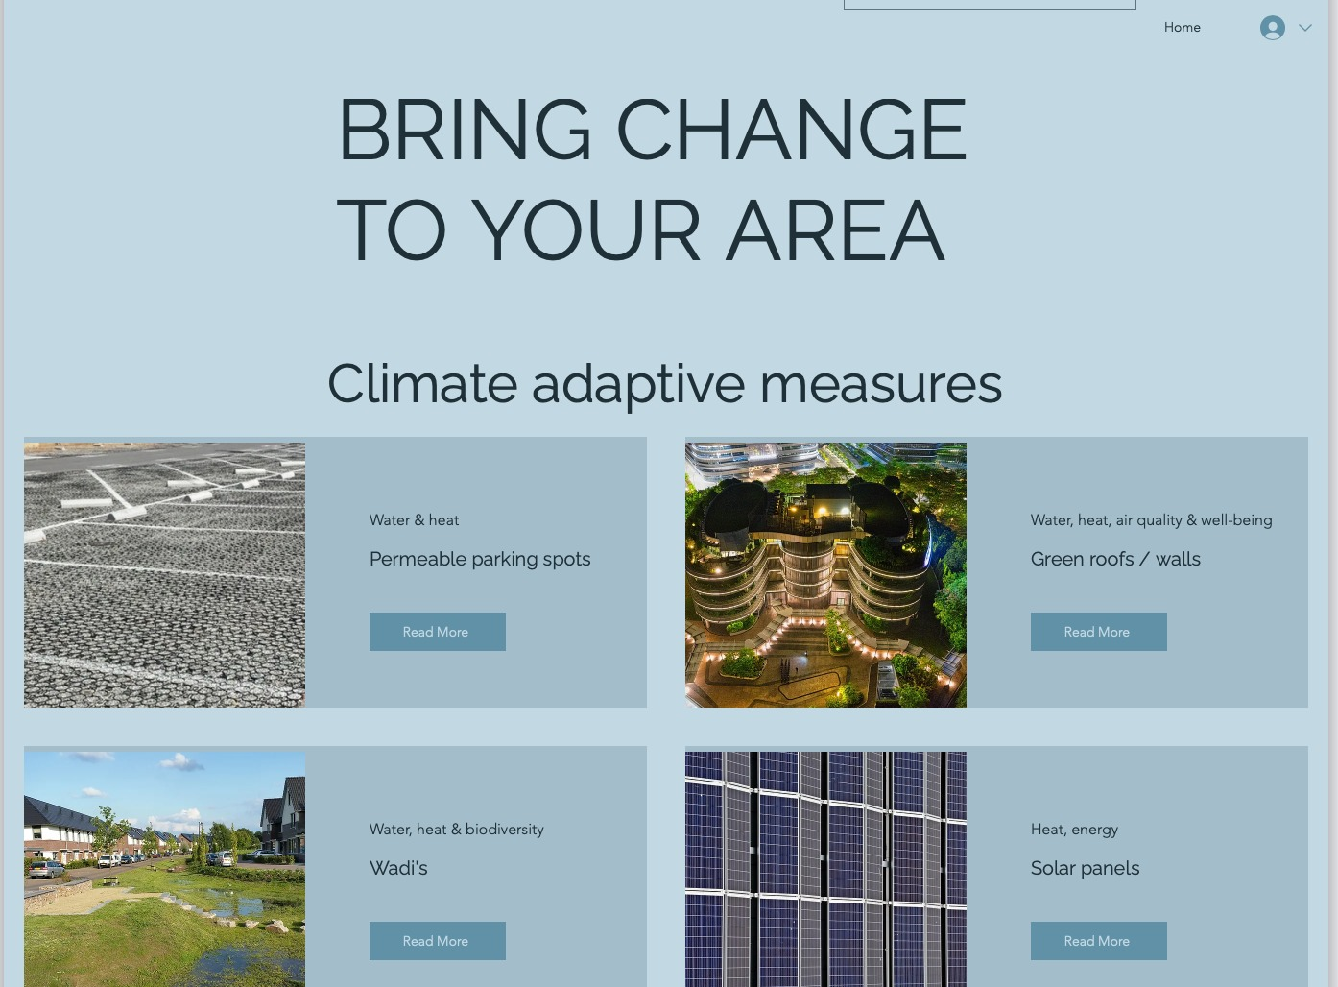
MORE INFO
Find knowledge clips and more information (including calculations) on [insert website]
Notes:
On this website, you can find a step-by-step process to bring change to your area. To play a role in making your area greener, healthier and more liveable.

Slide 11
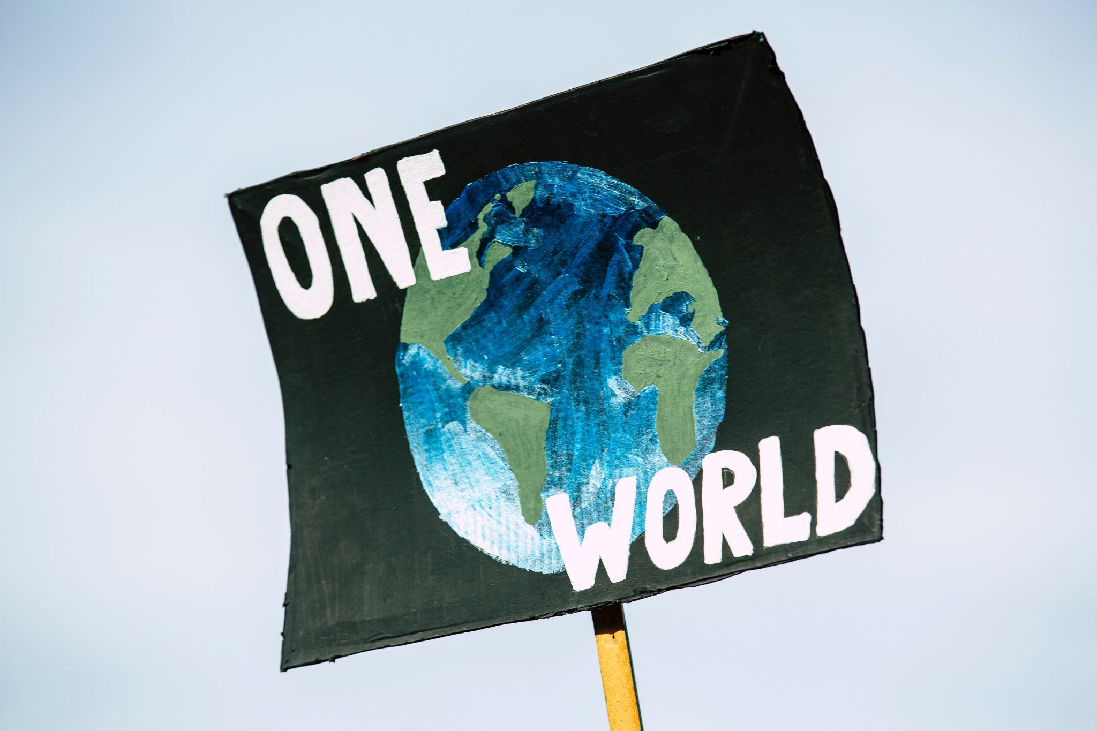
WHAT CAN YOU DO?
Whether you are the CEO, a facility manager, a client or another actor,
you can always play a role.
Inspire people around you by informing them about climate adaptation and how its practical examples can help your direct environment.

Slide 12
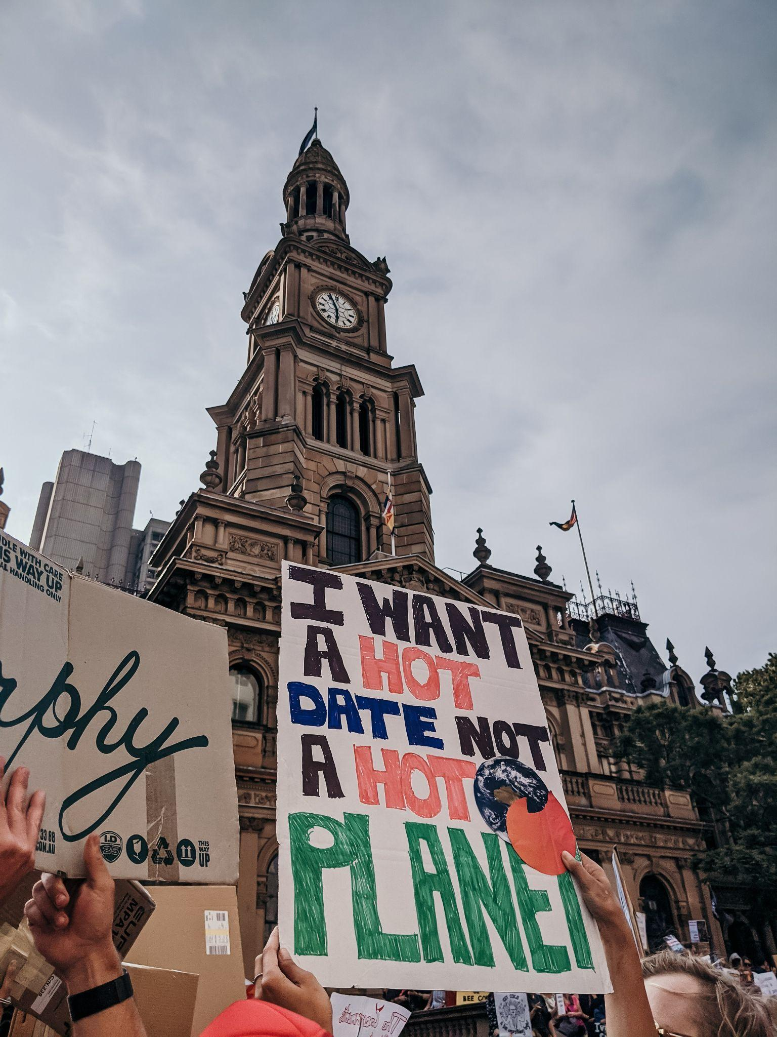
THANKS
‘Believe in the power of your own voice. The more noise you make, the more accountability you demand from your leaders, the more our world will change for the better’ - Al Gore
Go to [insert website] to find conversation starters, flyers and more.

